Slide 1
Measuring HIV Incidence among Key Populations, Young Adults and Adolescents
July 22nd, 2018
Joep Lange Institute, Amsterdam
Jessica E. Justman, M.D.
Senior Technical Director
ICAP at Columbia
Notes:
Background image: http://www.aidsdatahub.org/sites/default/files/documents/National_Estimate_of_HIV_2012.pdf

Slide 2
Disclosure of Speaker’s Interests
No conflict of interests

Slide 3
Overview
Measuring HIV Incidence among Key Populations, Young Adults and Adolescents
Background
Why measure HIV incidence
Current HIV incidence estimates
Methods: focus on direct measures and sampling
Challenges
Future

Slide 4
Why Measure HIV Incidence?
Measure ‘leading edge’ of epidemic
Quantify number of new infections
Expose trends, risk factors and risk groups
Guide prevention efforts
Essential tool in HIV prevention clinical trials
Assess impact of prevention and treatment programs
Identify who is missing out on benefit of efforts
Aid advocacy and accountability efforts
Notes:
-

Slide 5
Definition of Priority Populations (PP)
Population groups at elevated risk of new infection based on specific demographic features who account for large numbers of new HIV infections*
Adolescent girls and young women (AGYW), and young men are main PP in high prevalence settings, particularly sub-Saharan Africa
Depending on the context, PP also include:
Prisoners, partners of PWID, and other vulnerable or marginalized groups (e.g., migrants, refugees)
Certain occupational groups such as miners, fishermen, farm workers, truck drivers, and uniformed personnel
*http://www.unaids.org/sites/default/files/media_asset/20151019_JC2766_Fast-tracking_combination_prevention.pdf Pgs. 14-15

Slide 6
Definition of Key Populations (KP)
Population groups at elevated risk of new infection based on specific risk behaviors
May vary by country but common features:
Higher prevalence than general population
Often a marginalized, stigmatized, “hard-to-reach” group
Resources may not be geared to needs of group
UNAIDS Key Populations*:
People who inject drugs (PWID)
Gay men, men who have sex with men (MSM)
Transgender persons
Sex workers and their clients
*http://www.unaids.org/en/topic/key-populations

Slide 7
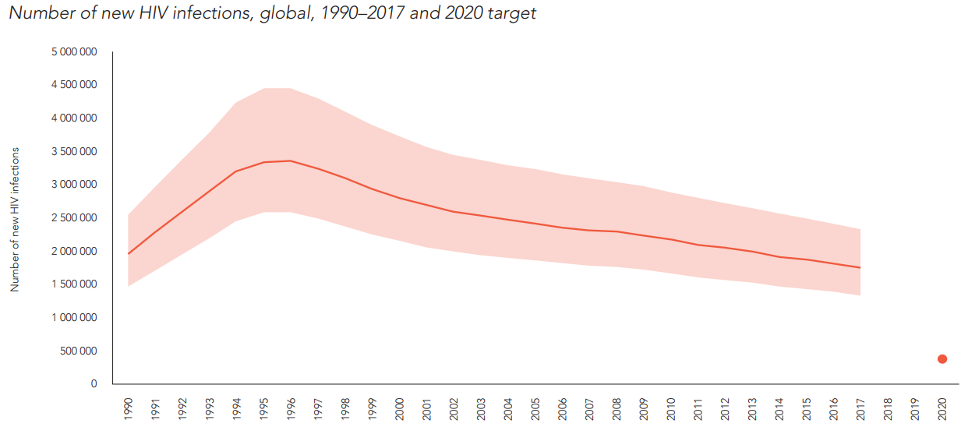
Estimates of Global Number of New HIV Infections
Estimates of new infections largely based on models
1.8 million
1990
2020

Slide 8
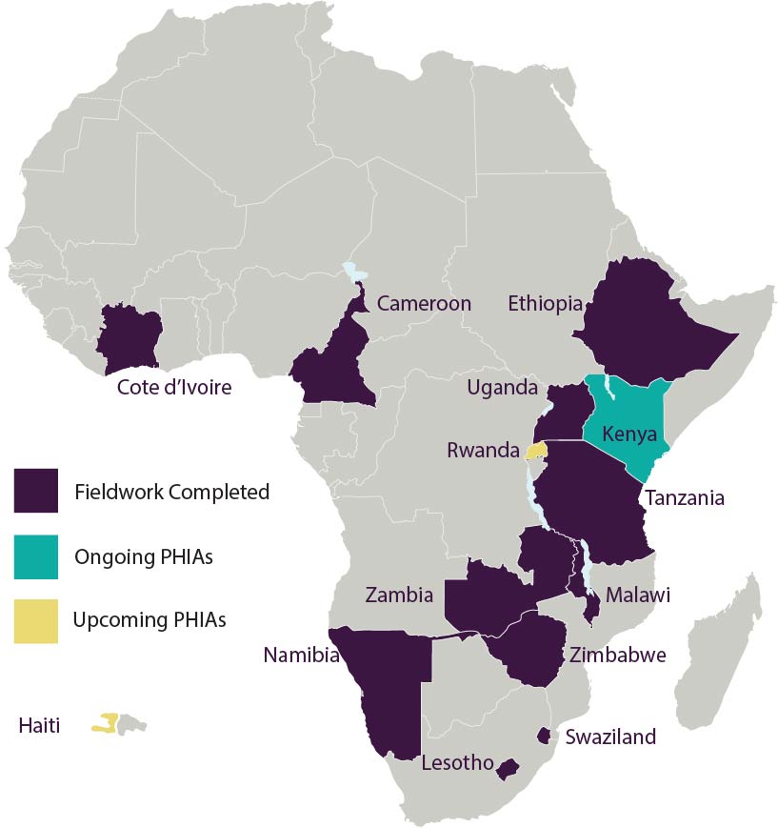
PHIA Project: National HIV Incidence Measures
Population-based HIV Impact assessments (PHIA):
- nationally representative, HIV-focused household surveys to assess the status of the HIV epidemic and the impact of national programs through:
1^{o :} National HIV incidence and prevalence of viral load suppression
2º objectives: Adult and pediatric HIV prevalence, drug resistance, detectable ARVs CD4 distribution, among others
phia.icap.columbia.edu
Notes:
Can

Slide 9
National HIV Incidence General Population, Adults (15–49 years)
phia.icap.columbia.edu

Slide 10
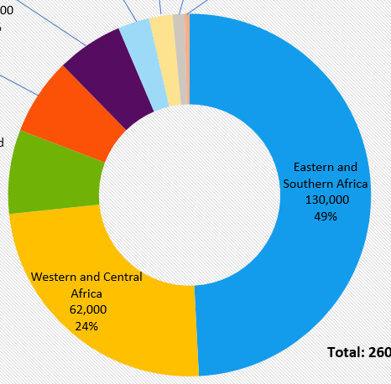
HIV Incidence in Priority Populations: Adolescents & Young Adults
In 2016, youth ages 15-24 accounted for 34% of all global new infections (610,000)
Gender: 2/3 new infections among youth are in adolescent girls
Location: most (73%) new infections among adolescents occur in sub-Saharan Africa
# and % new HIV infections
among AGYW 15-19, by region, 2016
Source: UNAIDS 2017 estimates
Data not available for North America

Slide 11
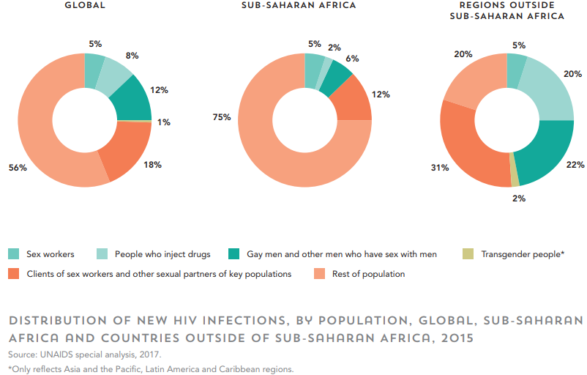
Key Populations are a Large Source of New HIV Infections
1.9 million new HIV infections in 2015
Of these, key populations and their sexual partners comprised:
80% of all new infections outside SSA
25% of all new infections in SSA
44% of new HIV infections globally

Slide 12
Methods: Directly Observed Incidence Measurements
Prospective cohort studies
Based on observed HIV diagnosis (seroconversions)
Considered “gold standard” of direct measurement, but…
Expensive, difficult, time-consuming and prone to bias
HIV-uninfected Cohort
HIV testing
HIV testing

Slide 13
Methods: Directly Observed Incidence Measurements
Cross-sectional estimation using biomarkers
Using lab assays of individual blood samples, identify recent infections (last 4-6 months) and acute (A) infections (last 2 weeks)
Ex: LAg-avidity assay (used in PHIAs) for recent
Pooled nucleic acid testing (NAT) for acute
A
Recently infected Individuals
Window period (e.g., 6 mo.)
Time of infection
Time of sampling

Slide 14
Sampling: General Population Estimates PHIA Project and other general population survey
Two-stage, cluster sample designed to achieve nationally representative sample
phia.icap.columbia.edu

Slide 15
Oversampling for Priority Population Estimates
Problem: priority population, such as AGYW, may be a large component of the general population but be too small for a reliable sub-estimate
Solution: adjust survey design so that group makes up a larger share of the survey sample than they do in the population
Allows better estimate attributes (incidence) of the group
Weighting used to estimate size of population

Slide 16
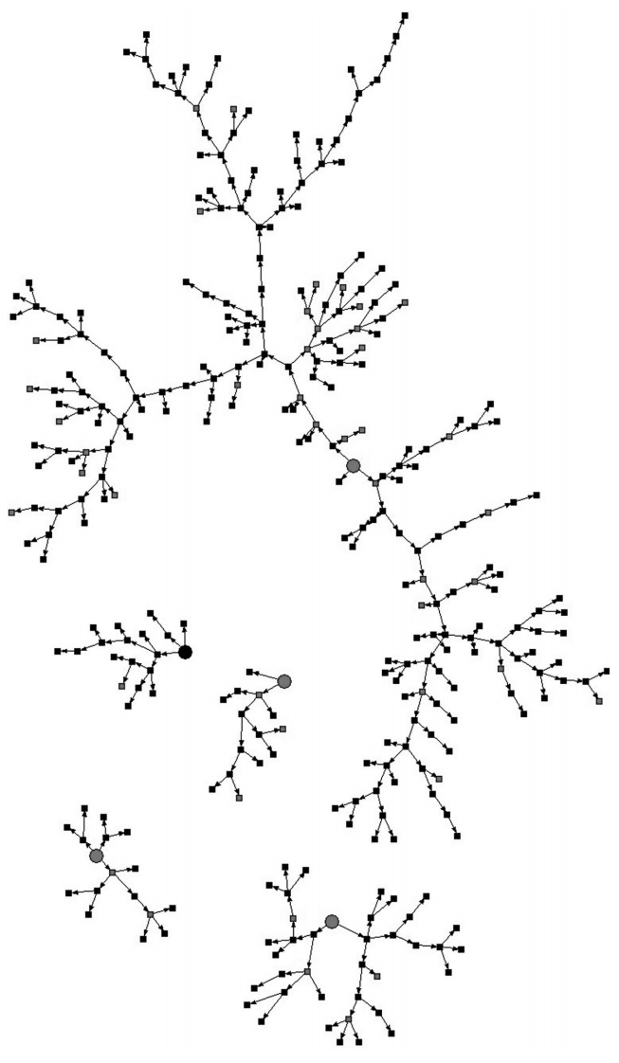
Sampling Methods for KP Surveys
Respondent-driven sampling (snowball sampling)
Members of hard-to-reach group refer additional people within their group to the survey
Study procedures are completed
Non-random sampling is later adjusted through mathematical weighting to compensate for biases
Wirtz AL, et al., 2013

Slide 17
Sampling Methods for KP Surveys
Venue-based sampling
Recruitment of target population at venues where the target population gathers
Construction of a sampling frame for venue day/time units helps approximate random sampling
Both respondent driven and venue based sampling used to estimate HIV incidence of target group
KP size estimation methods to calculate burden, e.g.:
Network scale-up
Catch and release

Slide 18
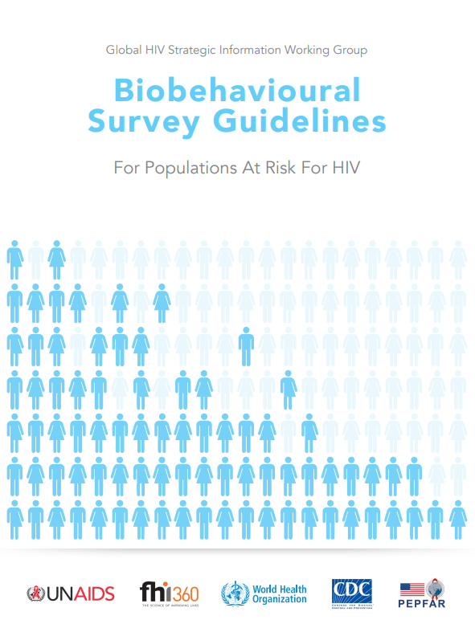
The “Blue Book” on Key Population Surveys
Tools for conducting surveys with KPs
Includes all basic aspects of survey methodology
Provide guidance on:
Biomarker considerations
Population size estimation
Questionnaire modules
Standard and newly proposed indicators
Notes:
http://apps.who.int/iris/bitstream/handle/10665/258924/9789241513012-eng.pdf;jsessionid=D538B724D0ACD4C222143DDA266A21BA?sequence=1

Slide 19
Challenges: HIV Incidence Estimates
Large sample sizes required
even in high incidence settings
applies to all direct methods and drives cost
Hawthorne effect
Change in behavior related to being observed in a study
limitation of prospective studies and relative advantage of cross-sectional surveys
Total person-year observations required for 2-arm trial
Power=0.80, alpha=0.05, 2-sided
Annual HIV incidence | Relative risk = 0.5 | Relative risk = 0.6
1.5% | 6,208 | 10,338
2% | 4,638 | 7,722
3% | 3,068 | 5,106

Slide 20
Challenges with Incidence Estimates
Retention
the ability to keep study participants enrolled until all study procedures have been completed
if highest risk individuals are lost, estimate will be lower than actual rate
Accuracy of testing algorithm
Ability to distinguish recent from chronic infections
Depends on antibody maturation response and performance characteristics of assay in specific population

Slide 21
Challenges with Incidence Estimates
Cross-sectional biomarker tests: ideal vs reality
Ideal assay for recent infection
Realistic assay for recent infection
“window
period”
Probability of positive test for recent infection
“window
period”
“tail”

Slide 22
What Existing Incidence Estimates Don’t Tell Us
What is happening at other points in time and changes in incidence trends
When, where and how target population is most at risk
Impact and extent of migration into and out of specific areas
Lack of data in some areas (e.g. Russia and the Middle East)
Insufficient detail to inform the type of interventions needed

Slide 23
Future of HIV Incidence Measures: The Search for Surrogates
Trends in population viral load measures as surrogates for HIV incidence
Require lower sample sizes than cross-sectional lab assay incidence estimation
Viremia among PLHIV versus viremia among entire (sub) population
Biomarker discovery trial
Improved recency assays that take fuller advantage of antibody maturation patterns
Other biomarkers (e.g., IP-10) to screen for inflammatory markers of acute HIV infection
IP-10 = Interferon-γ–Inducible Protein 10

Slide 24
The Future of Incidence Measures
Rapid HIV recency testing
May be used to estimate incidence and improve surveillance without altering routine HIV care
Results in minutes
Ease-of-use may also facilitate measurements in PP and KP groups
e.g., Asante assay

Slide 25
Many Unanswered Questions Remain
Will ART and PrEP scale-up make recency assays harder to use?
Are there other ways to measure viral exposure besides host antibody and inflammatory markers?
Do we still need directly observed incidence?
Is it necessary to track outcomes of HIV-uninfected individuals to monitor the epidemic
Or would it be sufficient to track parameters of HIV-infected individuals, such as proportion on ART, proportion with high viral load?

Slide 26
Summary and Conclusion
Direct measures of HIV incidence important for PP, KP and all populations
Assess the ‘leading edge’ and guide prevention efforts
Methods for PP and KP incidence measurement:
Testing technology influences design for all populations
Sampling is challenge for all measures of incidence
Recency assays: improving technology
Better ways to distinguish recent antibody profile
Rapid, point-of-care methods
Combination of indicators as the way forward

Slide 27
Thank You
ICAP: Johnny Wylie and colleagues
JLI: David Barr and colleagues

